Slide 1
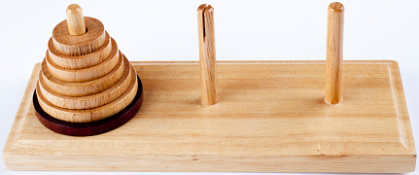
Towers of Hanoi AR
Augmented Reality Mini Project
Group members: Luka Uršič, Miha Štih, Marko Lumbar
Koper, 2024

Slide 2
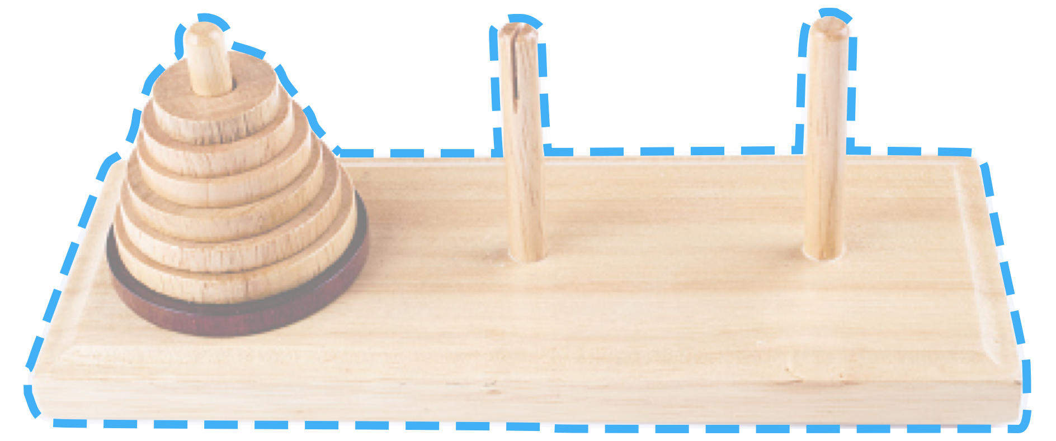
Towers of Hanoi
A classic puzzle game
Move disks from first stick to the last
One disk at the time
Don't put larger piece on smaller one

Slide 3
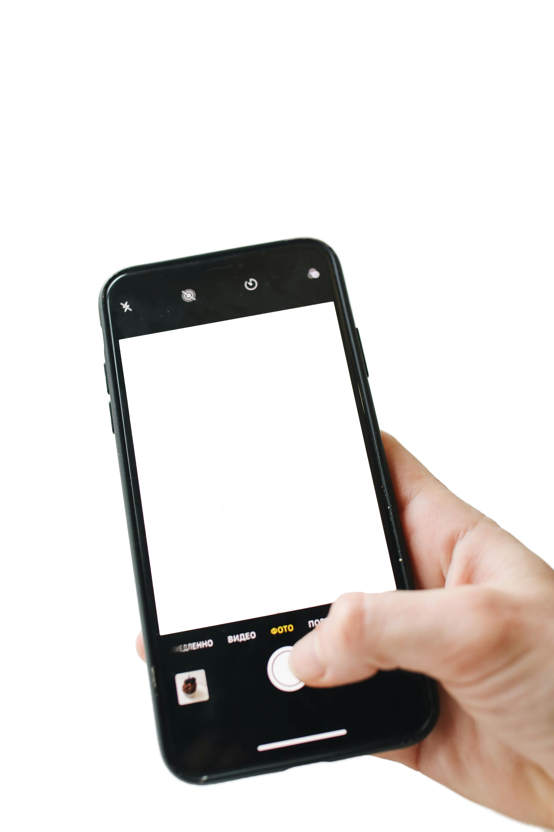
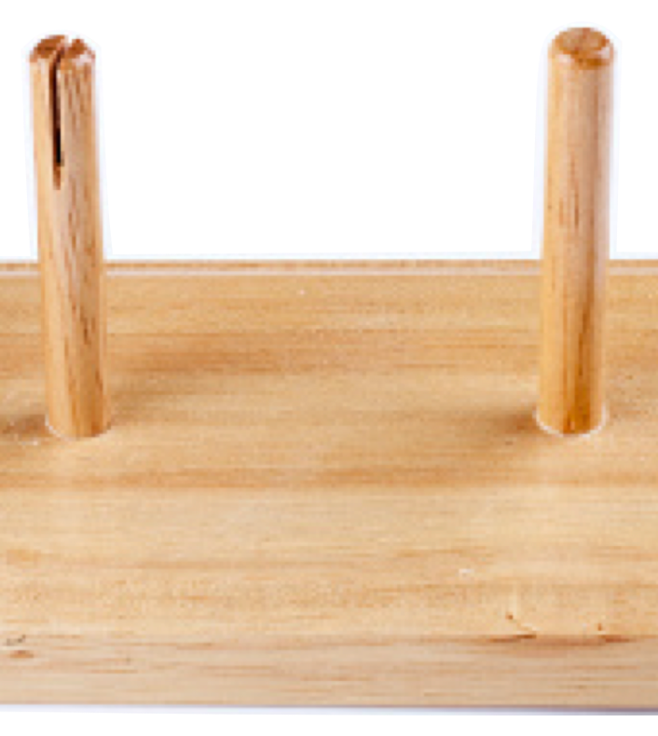
AR
Towers of Hanoi
See the game on your phone
Select the disk with real world object

Slide 4
AR
Towers of Hanoi
Development Roadmap
Select the disk by clicking on it
Select the disk with real world object
Smooth animation
Move disk freely

Slide 5
Work distribution:
Luka: Scripting & logic
Miha: Animations & object tracking
Marko: Scene and assets

Slide 6
Thank you for your attention

